Slide 1
Getting Started with Windows on the Intel Galileo
Bret Stateham
Microsoft Technical Evangelist
bretstateham.com
@BretStateham

Slide 2
Overview
Windows Developer Program for IoT
Installing Windows on Galileo
Running Code
In Windows
Next Steps

Slide 3
Windows Developer Program for IoT

Slide 4
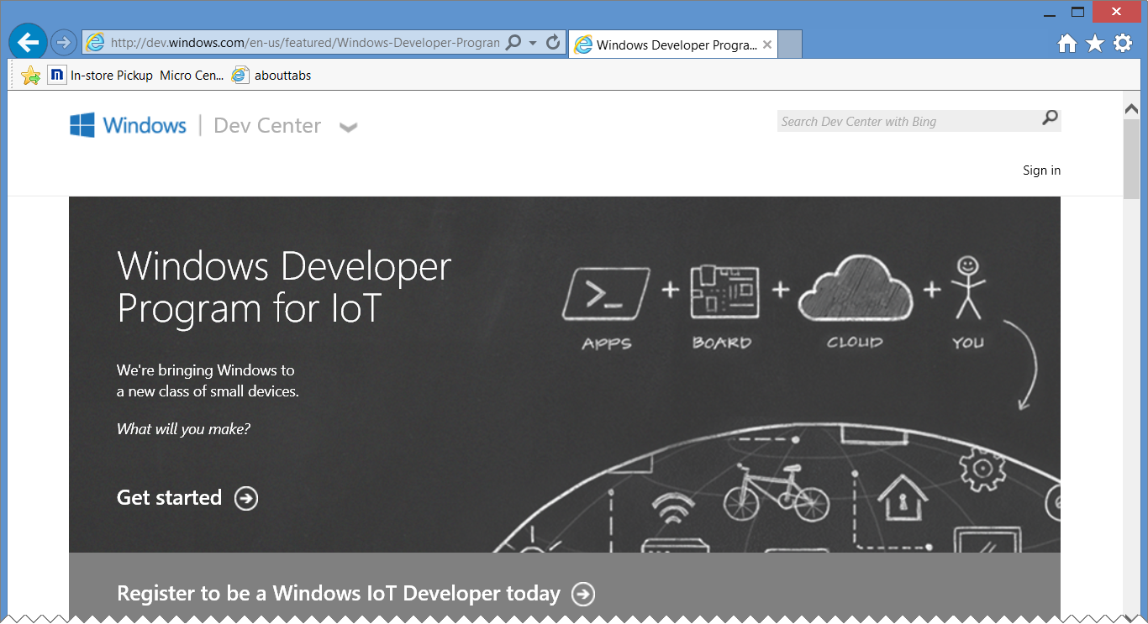
Windowsondevices.com
http://windowsondevices.com/

Slide 5
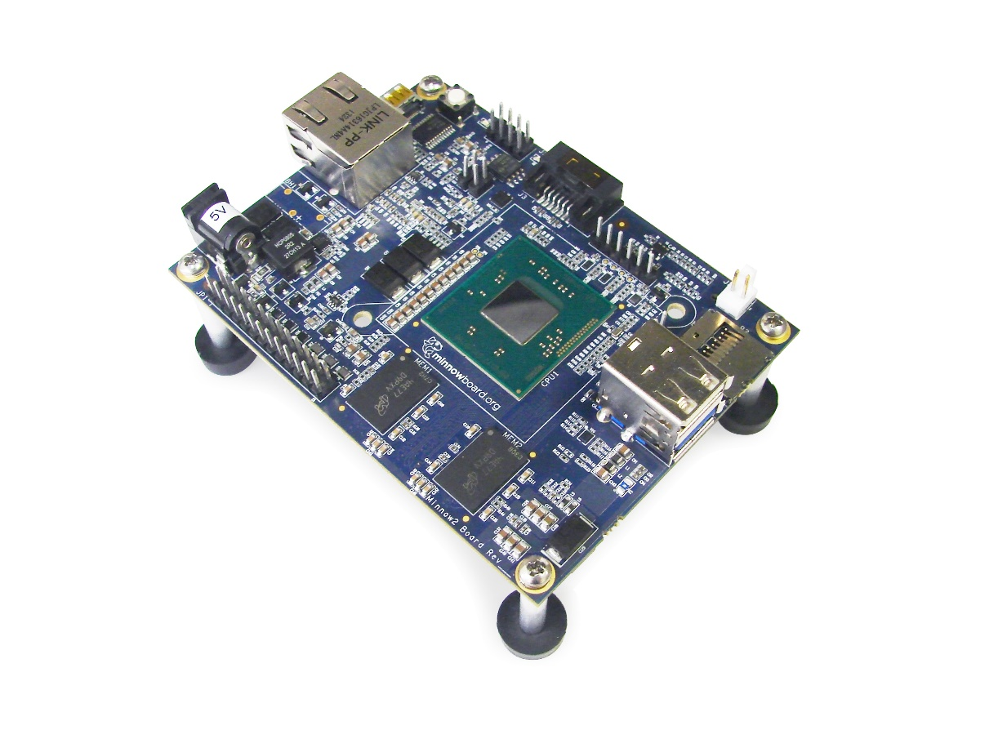
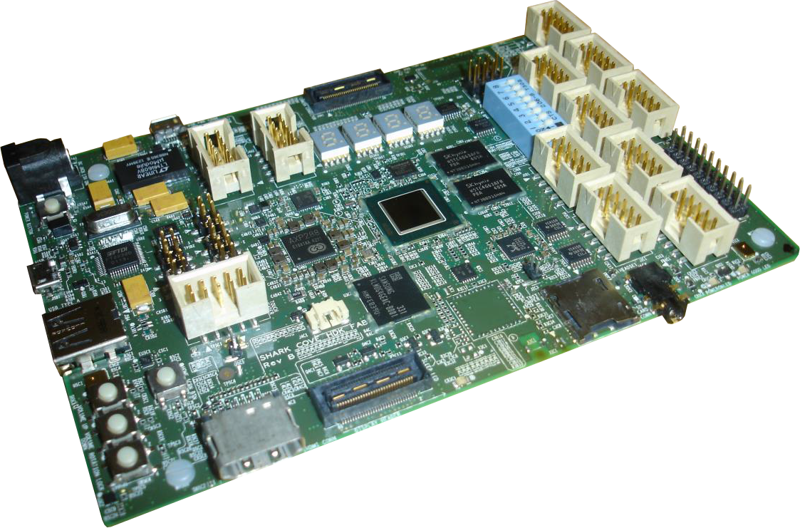


More than just galileo…
http://aka.ms/msmb
http://aka.ms/msscb

Slide 6
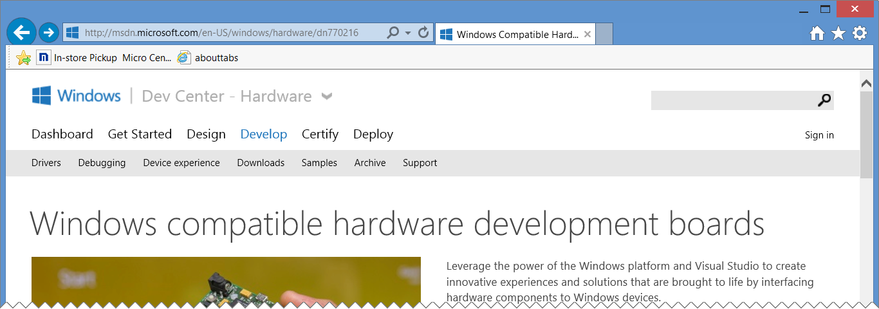
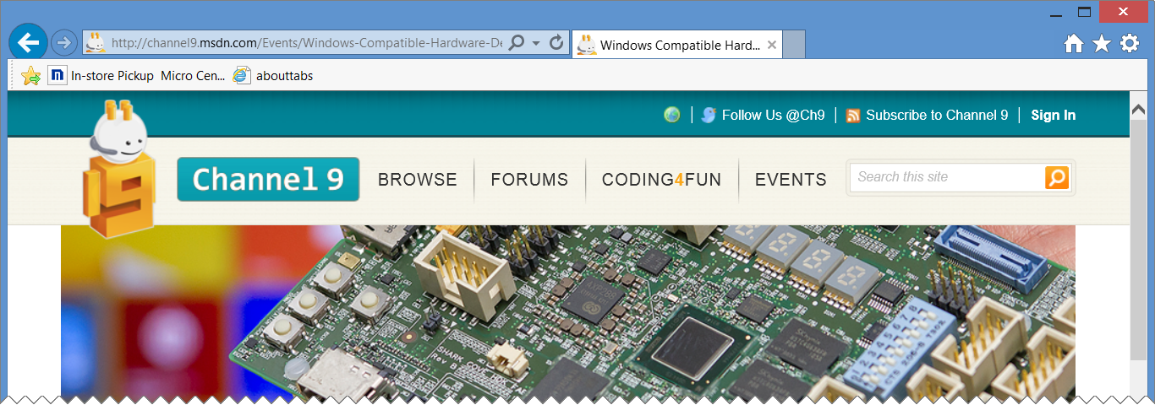
Windows compatible hardware development boards…
http://aka.ms/wchdb
http://aka.ms/wchdblive

Slide 7
Installing windows on galileo

Slide 8
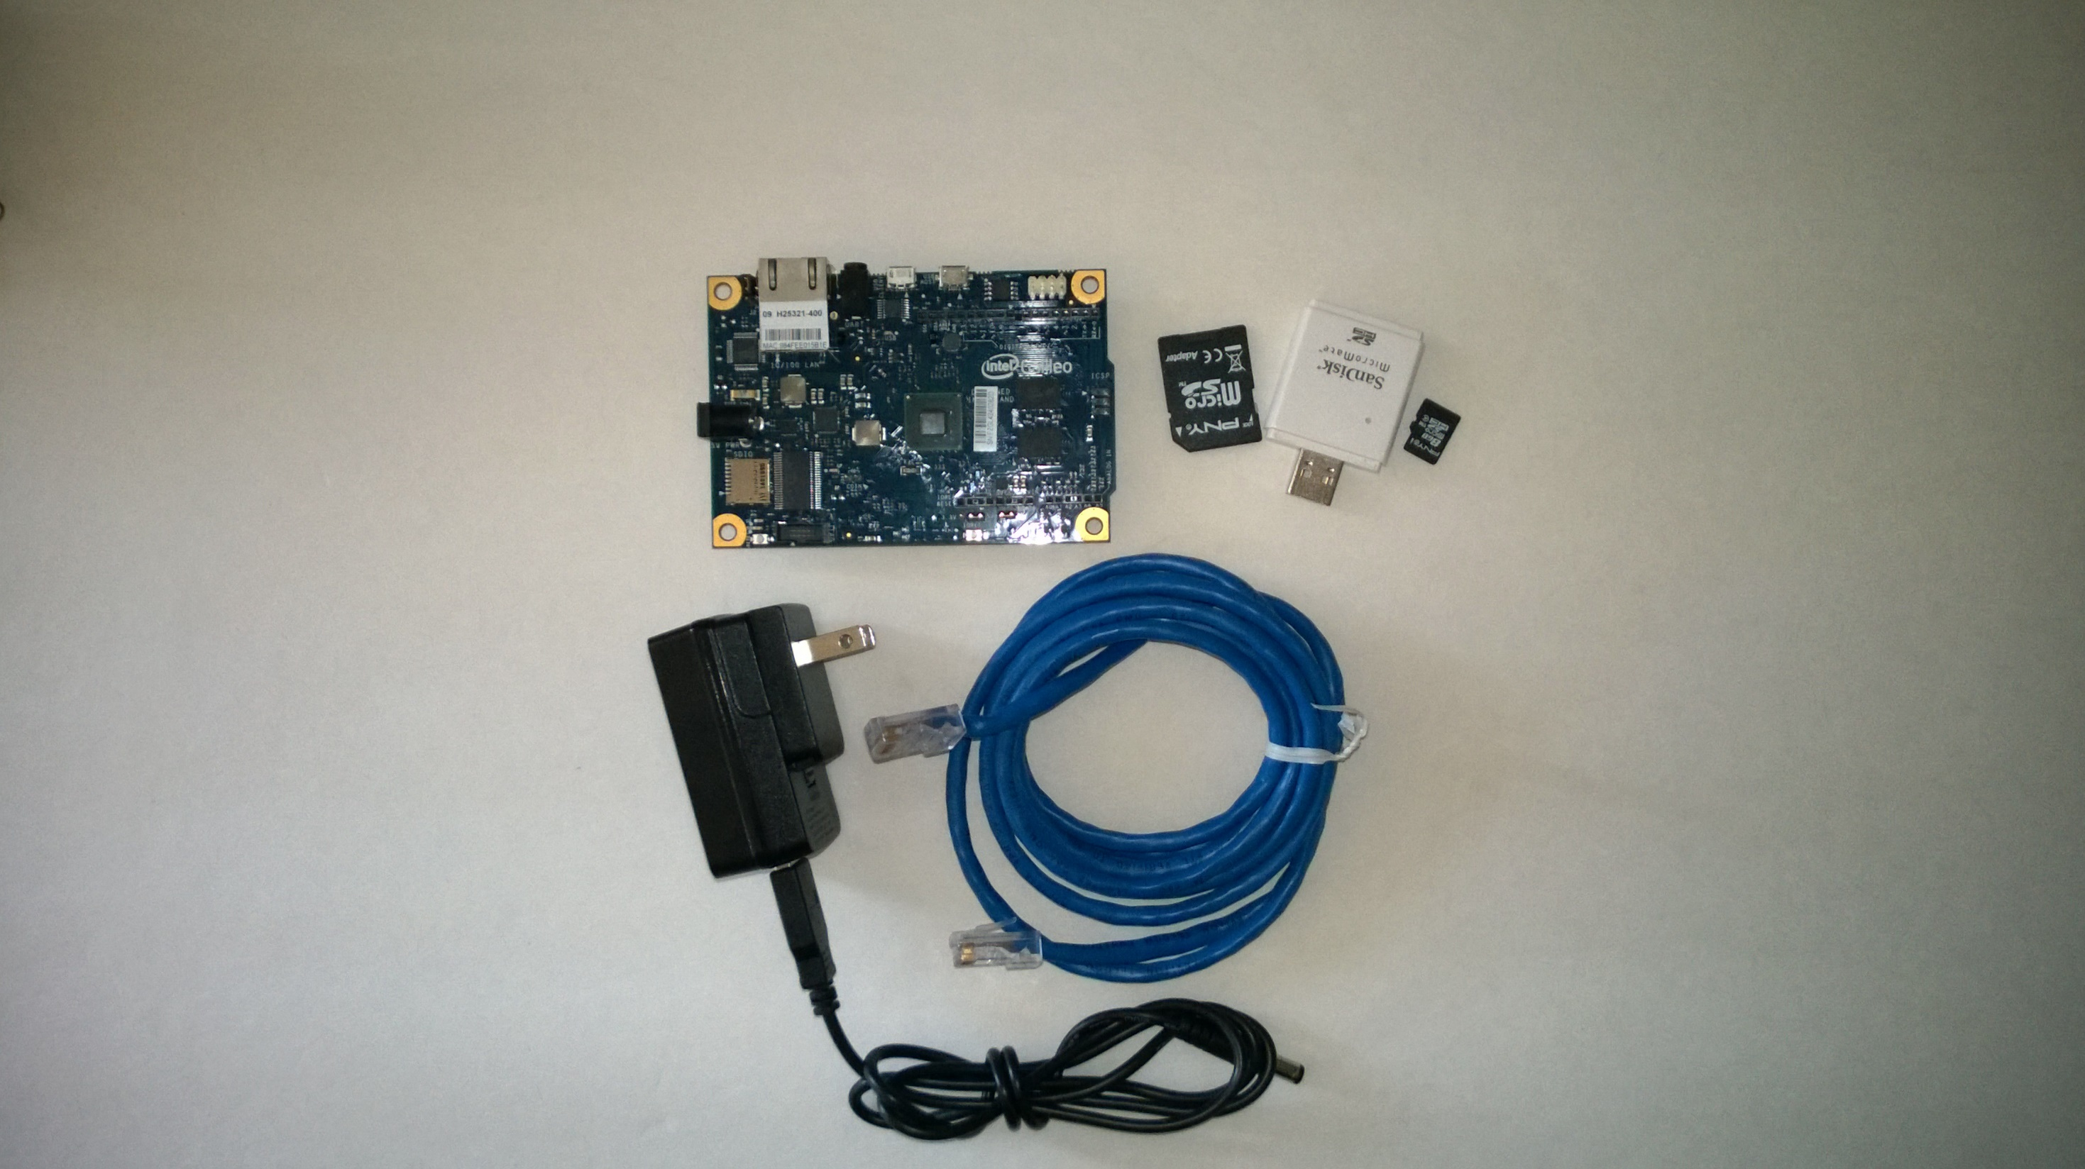
Here’s the hardware you need…

Slide 9
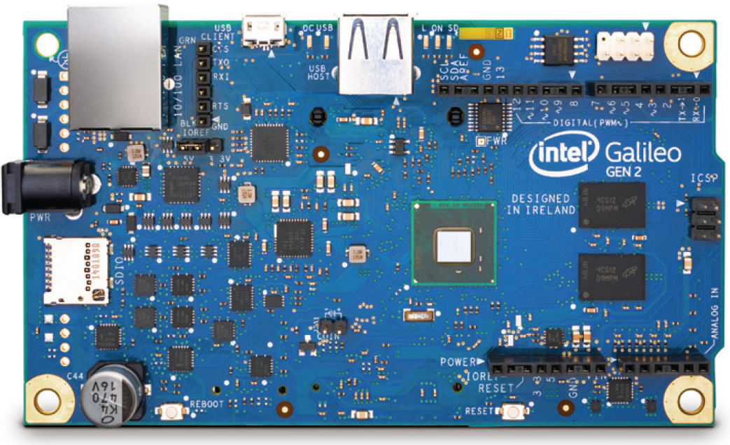
Gen 2 boards are NOT supported (yet)…
The embedded team hasn’t made any announcements or promises, but I hope to see support for the Gen 2 boards in the future.

Slide 10
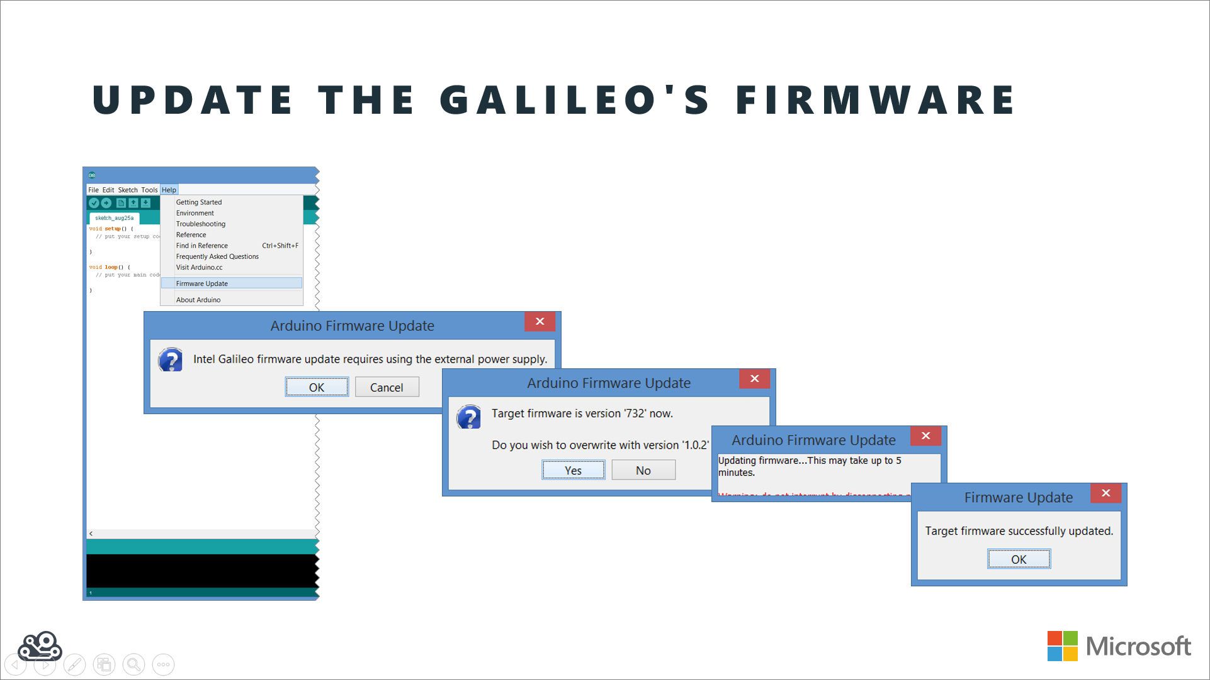
Ensure your firmware is updated
http://youtu.be/zUZmWe8nrc4

Slide 11
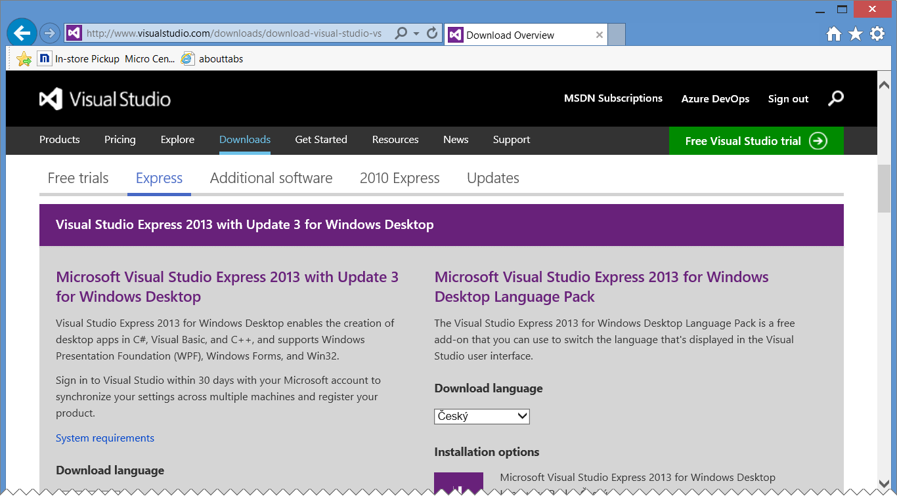
Install visual studio 2013…
Can use Visual Studio Express 2013 for Windows Desktop or a full version of Visual Studio http://visualstudio.com/downloads/

Slide 12
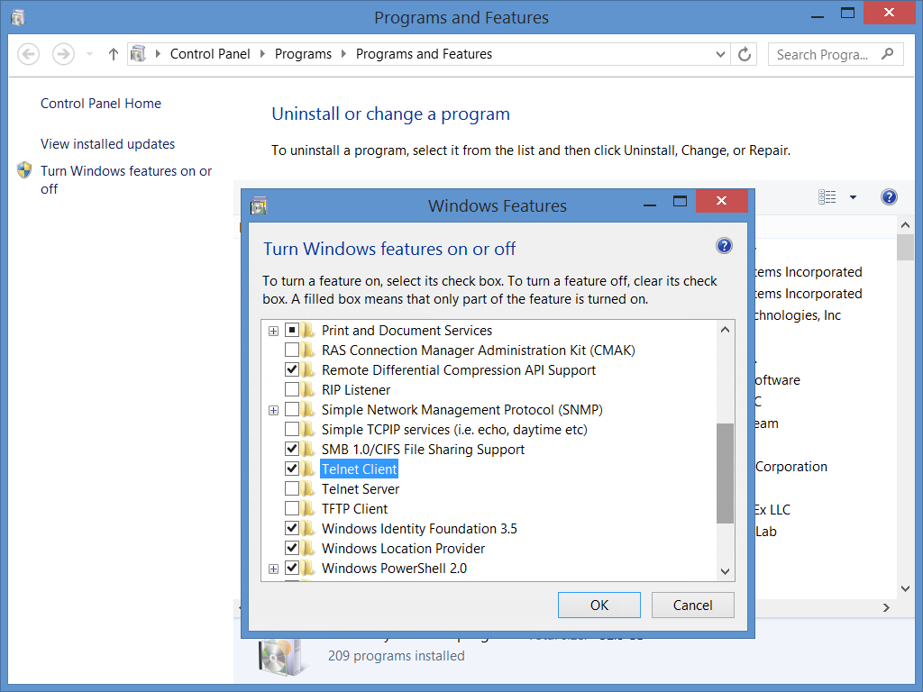
Install the telnet client…
You’ll use telnet to communicate with your Galileo. A telnet client ships with Windows, but isn’t installed by default. You‘ll need to add it manually…

Slide 13
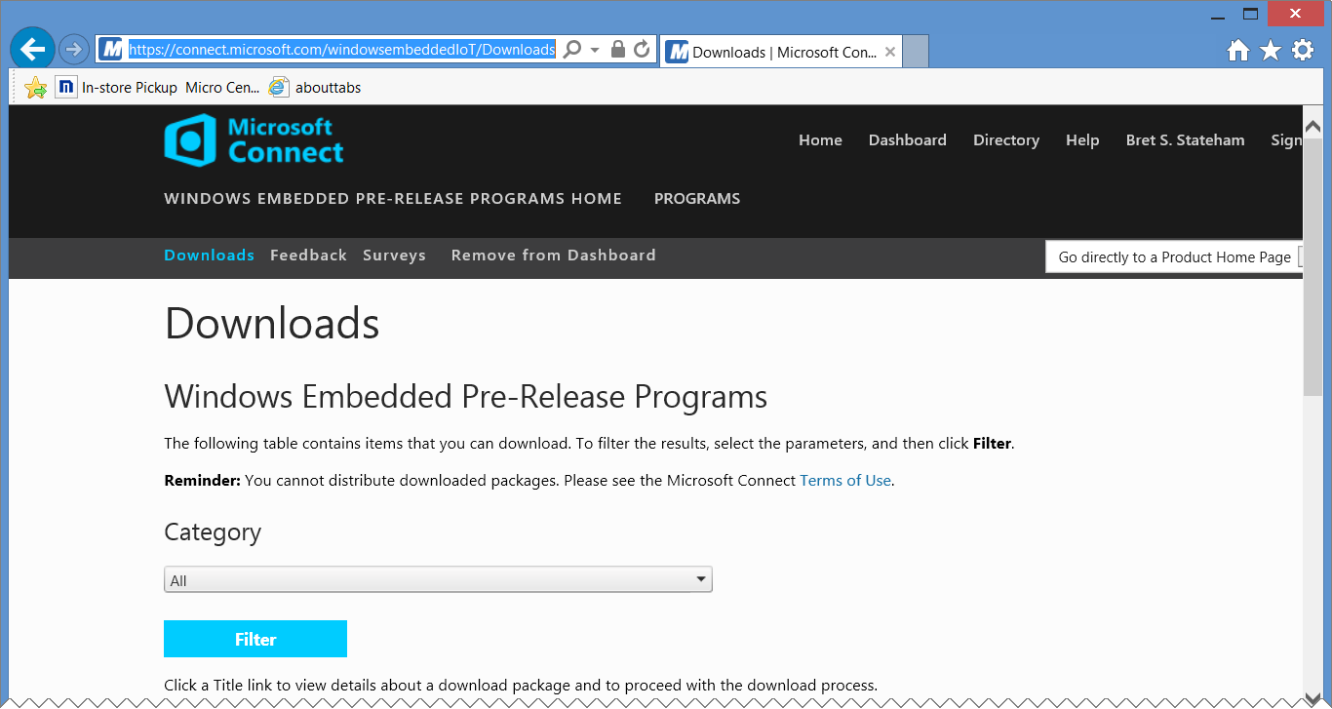
Download the windows image and tools…
Download | Description
Windows Developer Program for IoT – Microsoft Installer (MSI) | Installs Visual Studio project templates and GalileoWatcher.exe on your PC
Windows Developer Program For IoT – Windows Image (WIM) | The actual windows image that will be applied to the SD Card
Windows Developer Program For IoT – apply-bootmedia.cmd | The script to apply the WIM file (above) to the SD Card
https://connect.microsoft.com/windowsembeddedIoT/Downloads
You must have completed the registration process on windowsondevices.com before you can download

Slide 14
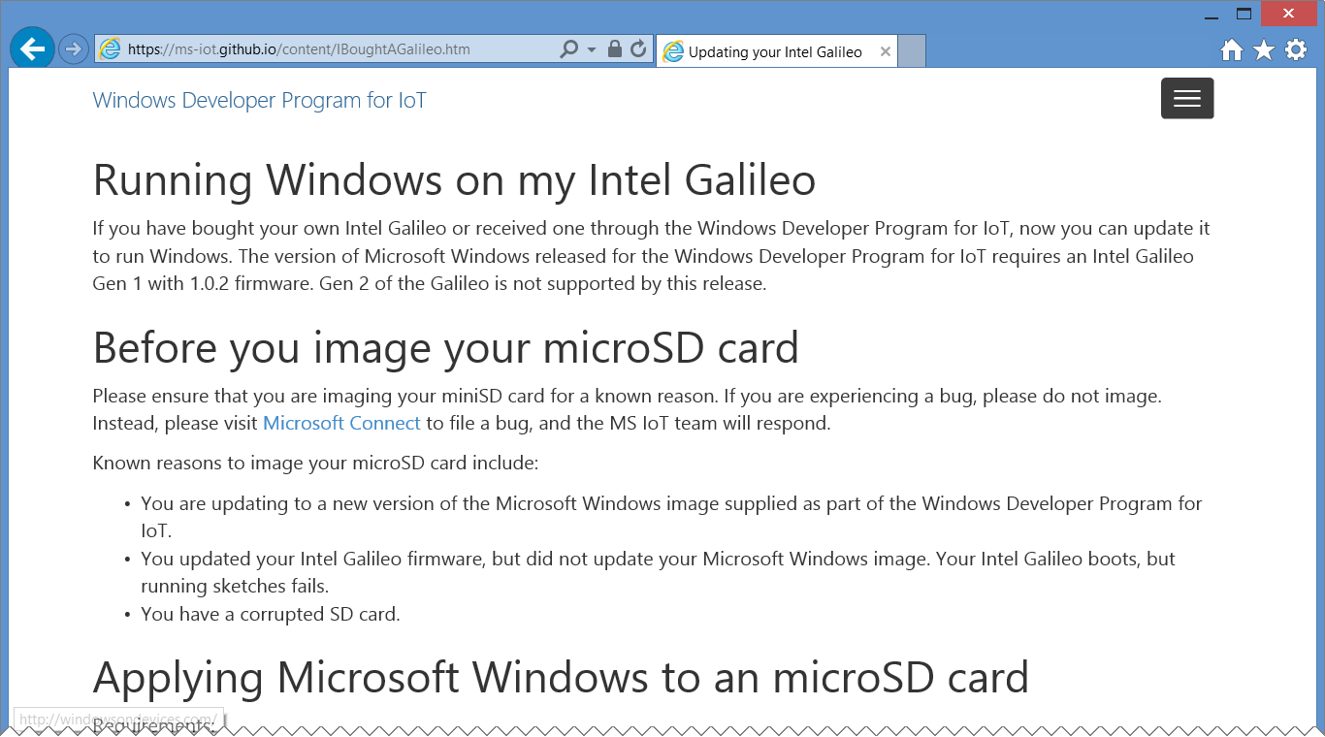
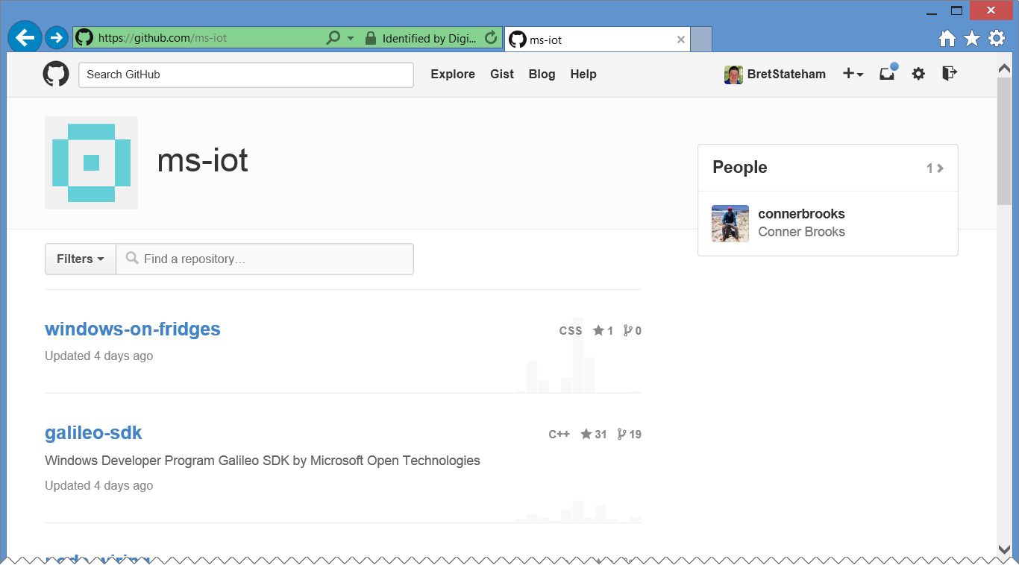
Resources and code on github…
http://ms-iot.github.io/content/IBoughtAGalileo.htm
https://github.com/ms-iot

Slide 15
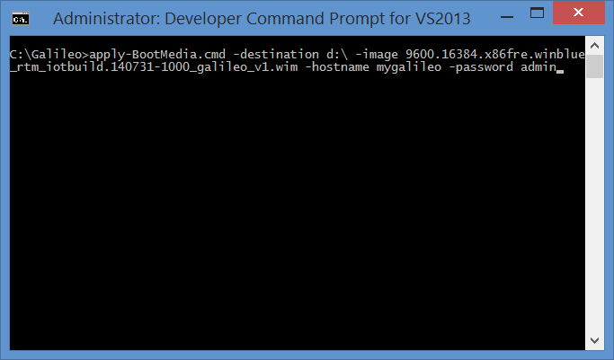
Install the windows image on your sd card…
C:\Galileo
apply-BootMedia.cmd
*.wim
D:\
efi
Program Files
Tools
Users
Windows

Slide 16
Boot galileo to windows…
You’ll receive a 169.254.*.* IPv4 address on both ends by default if you connect them directly (learn more)
SD IO Light Will Flicker
The entire boot process can take as long as two minutes

Slide 17
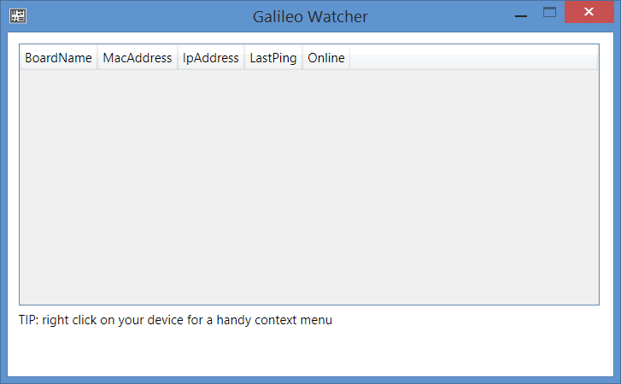
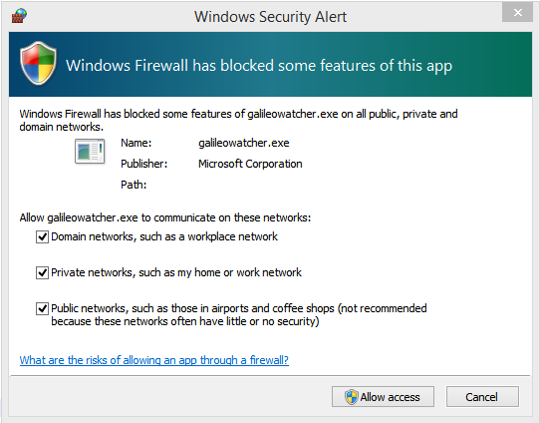
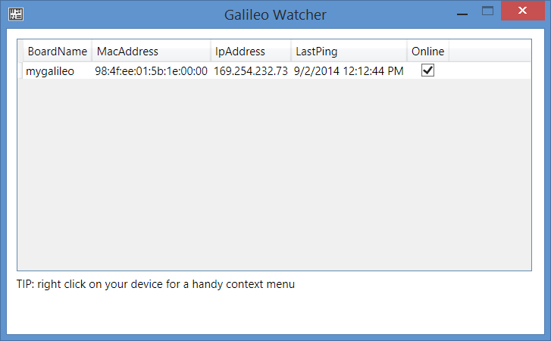
Run GalileoWatcher.exe on pC…
Installed as part of the: Windows Developer Program for IoT – Microsoft Installer (MSI)

Slide 18
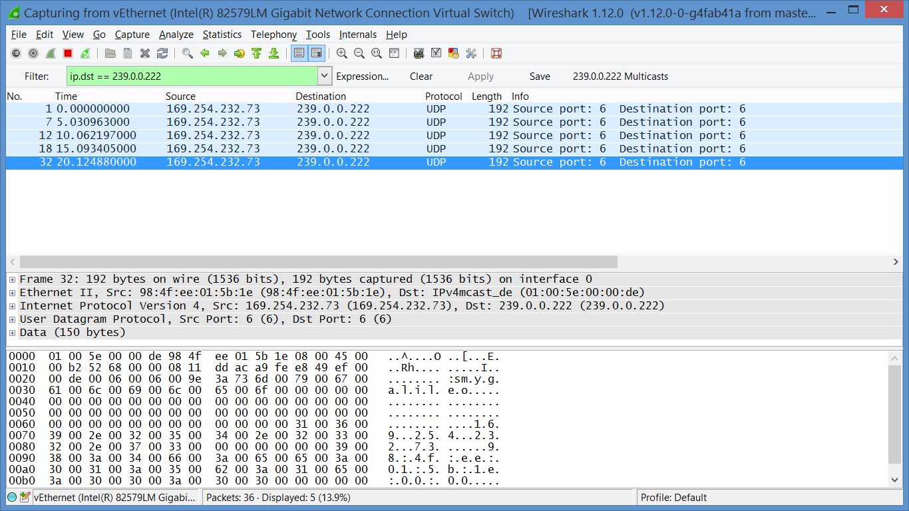
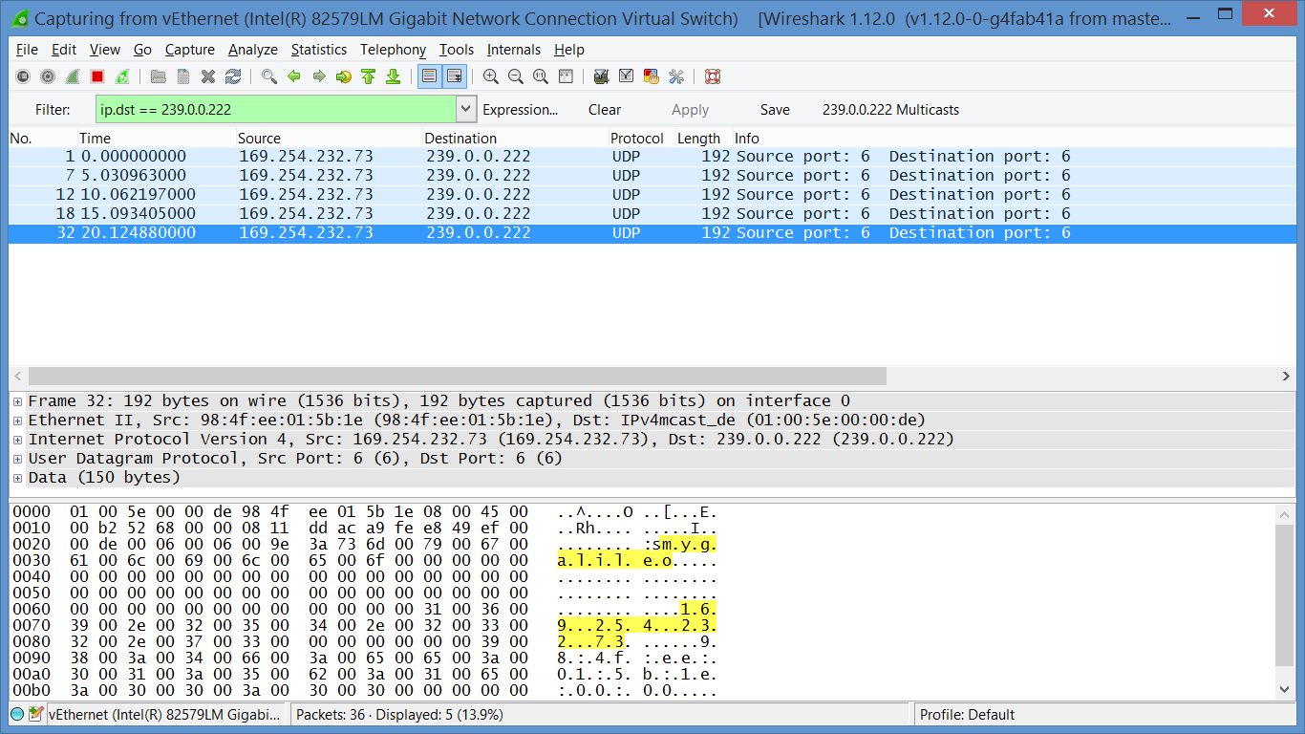
Galileo UDP multicasts…
hostname
IP Address

Slide 19
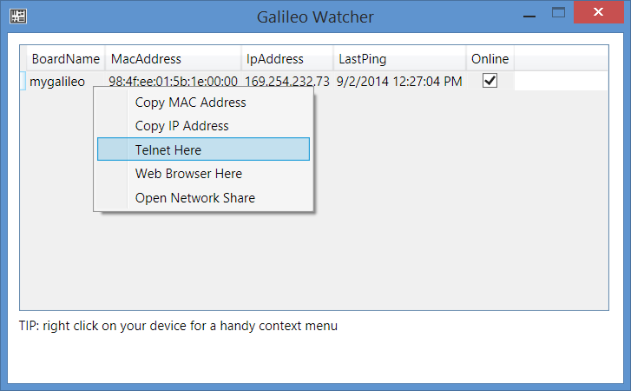
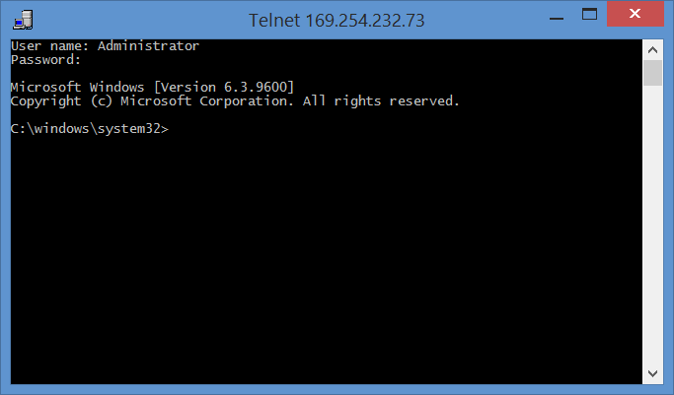
telnet into your galileo…
User name: Administrator Password: <Whatever you used in the apply-BootMedia.cmd execution> (admin)

Slide 20
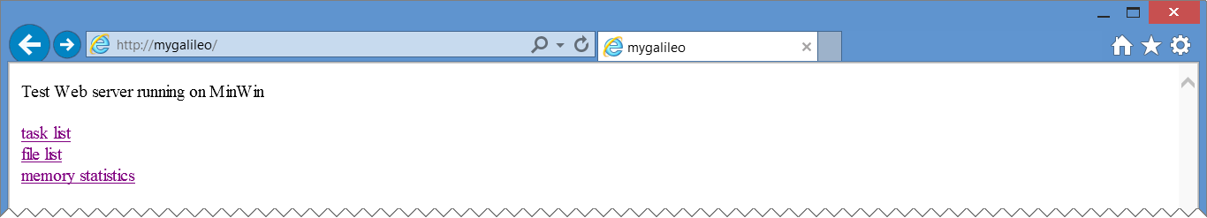
Browse to your galileo…
http://<your galileo hostname> or http://<your galileo ip addr>
“task list” shows a list of the running processes on your Galileo
“file list” hasn’t worked for me yet.
“memory statistics” shows your current memory status

Slide 21
Booting to Windows on your Galileo

Slide 22
Running code in windows

Slide 23
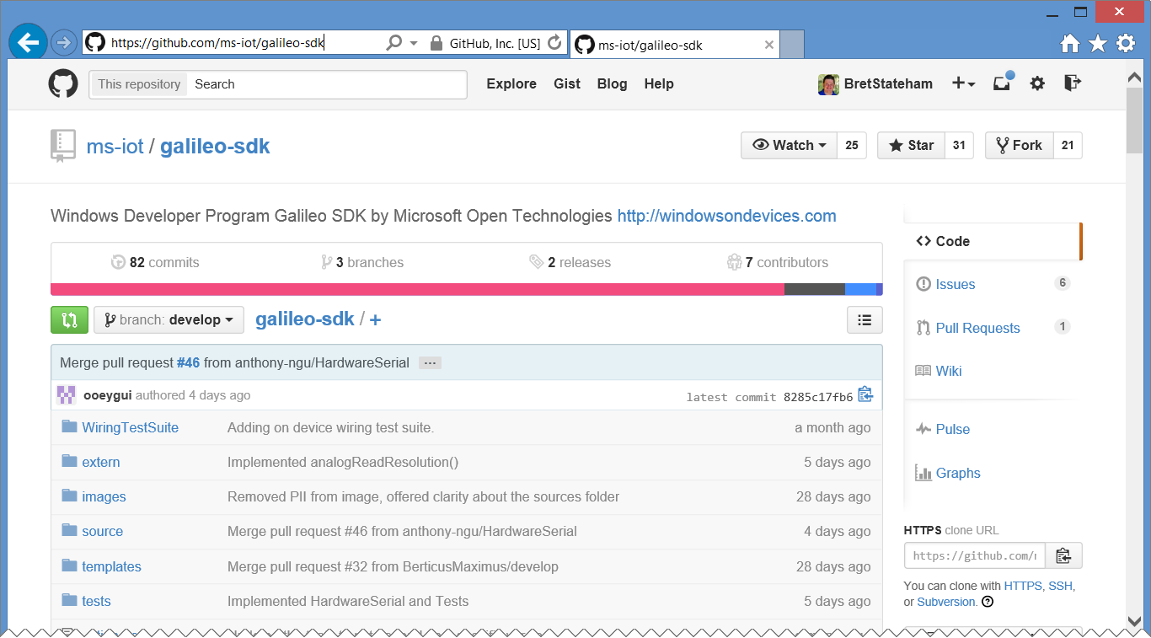
Galileo-sdk C++ wiring API implementation
https://github.com/ms-iot/galileo-sdk

Slide 24
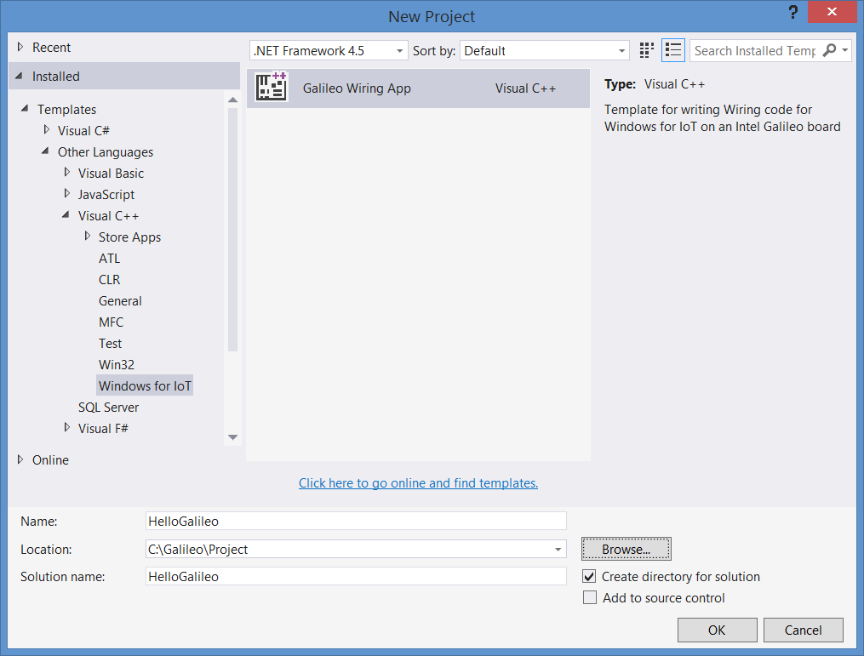
Galileo wiring app C++ project template
Installed as part of the: Windows Developer Program for IoT – Microsoft Installer (MSI)
It is basically a C++ console app that has references to the Galileo-SDK (Wiring API) to allow it to talk to the Arduino side of things.

Slide 25
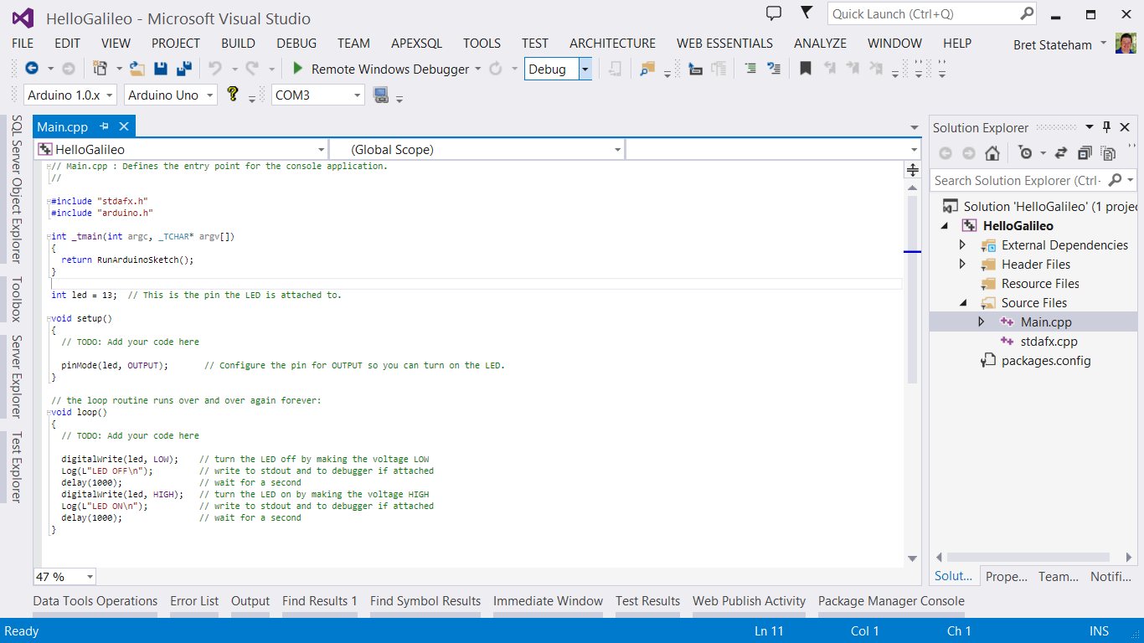
Main.cpp

Slide 26
Default sketch
// Main.cpp : Defines the entry point for the console application.
//
#include "stdafx.h"
#include "arduino.h"
int _tmain(int argc, _TCHAR* argv[])
{
return RunArduinoSketch();
}
int led = 13; // This is the pin the LED is attached to.
void setup()
{
// TODO: Add your code here
pinMode(led, OUTPUT); // Configure the pin for OUTPUT so you can turn on the LED.
}
// the loop routine runs over and over again forever:
void loop()
{
// TODO: Add your code here
digitalWrite(led, LOW); // turn the LED off by making the voltage LOW
Log(L"LED OFF\n"); // write to stdout and to debugger if attached
delay(1000); // wait for a second
digitalWrite(led, HIGH); // turn the LED on by making the voltage HIGH
Log(L"LED ON\n"); // write to stdout and to debugger if attached
delay(1000); // wait for a second
}
The Log() method writes output to stdout and to the debugger if it is attached

Slide 27
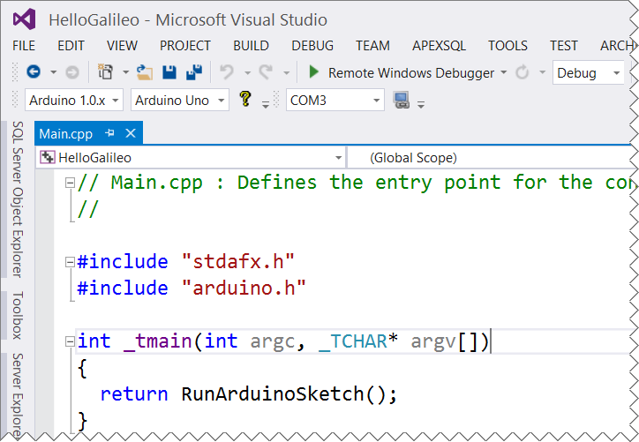
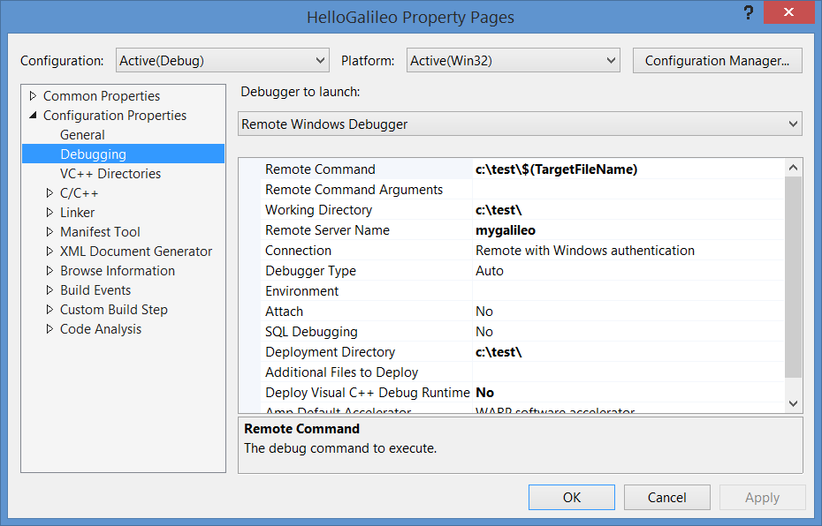
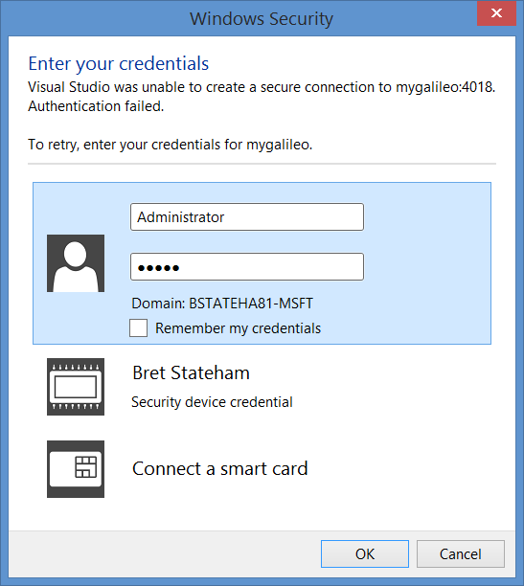
Remote debugging on your galileo…

Slide 28
Writing code on your Galileo

Slide 29
Next steps

Slide 30
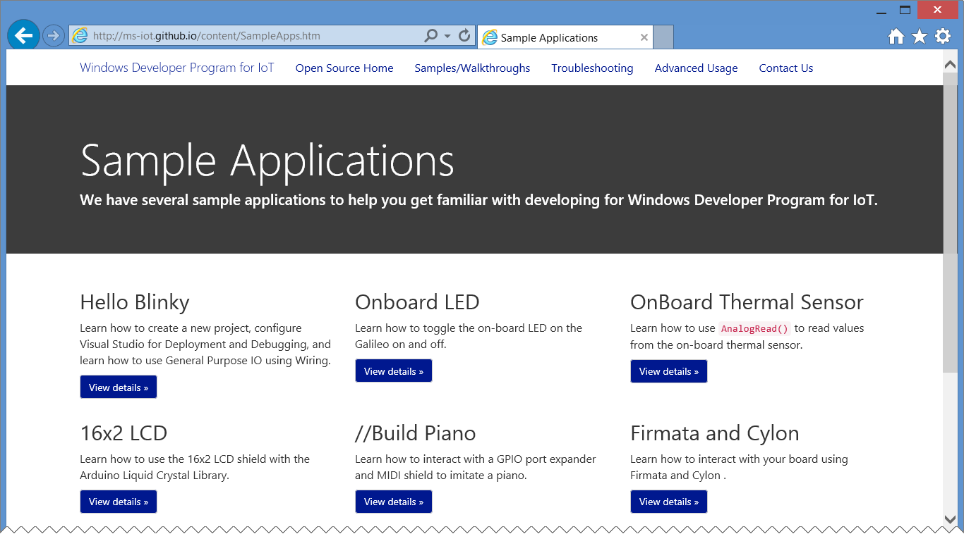
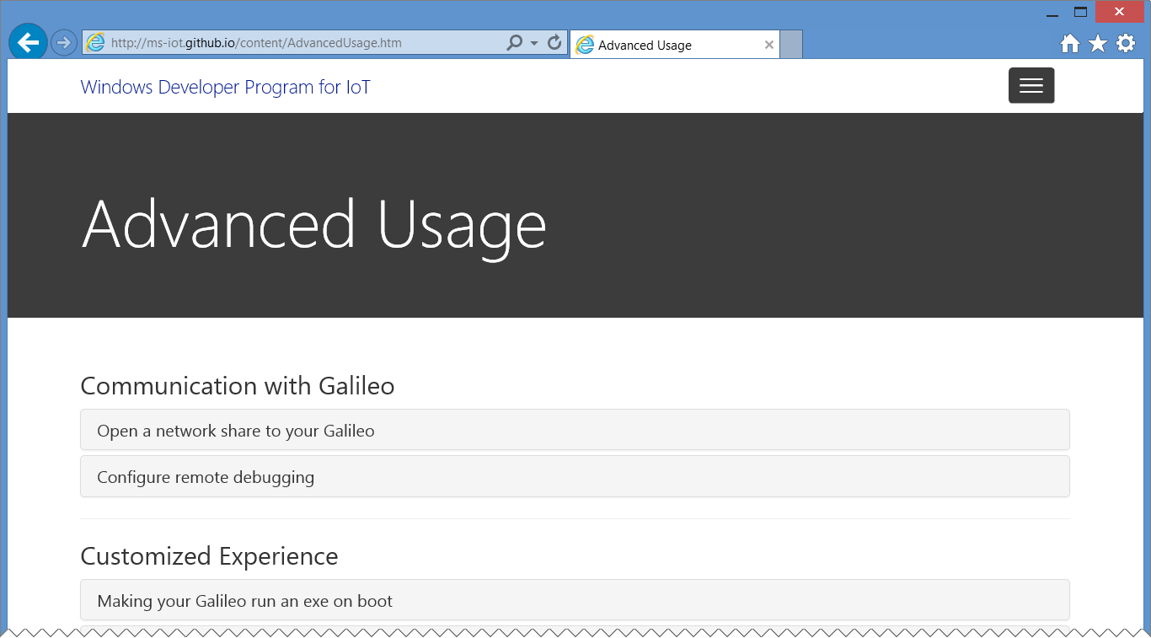
Explore other samples…
The //build/ piano demo
GPIO Direct
16X2 LCD
Communication and control with Firmata and Cylon
More to come!
http://ms-iot.github.io/content/SampleApps.htm

Slide 31
Advanced Usage…
Connecting to your Galileo
Configuring Remote Debugging
Running a sketch on boot
Troubleshooting, etc.
http://ms-iot.github.io/content/AdvancedUsage.htm

Slide 32
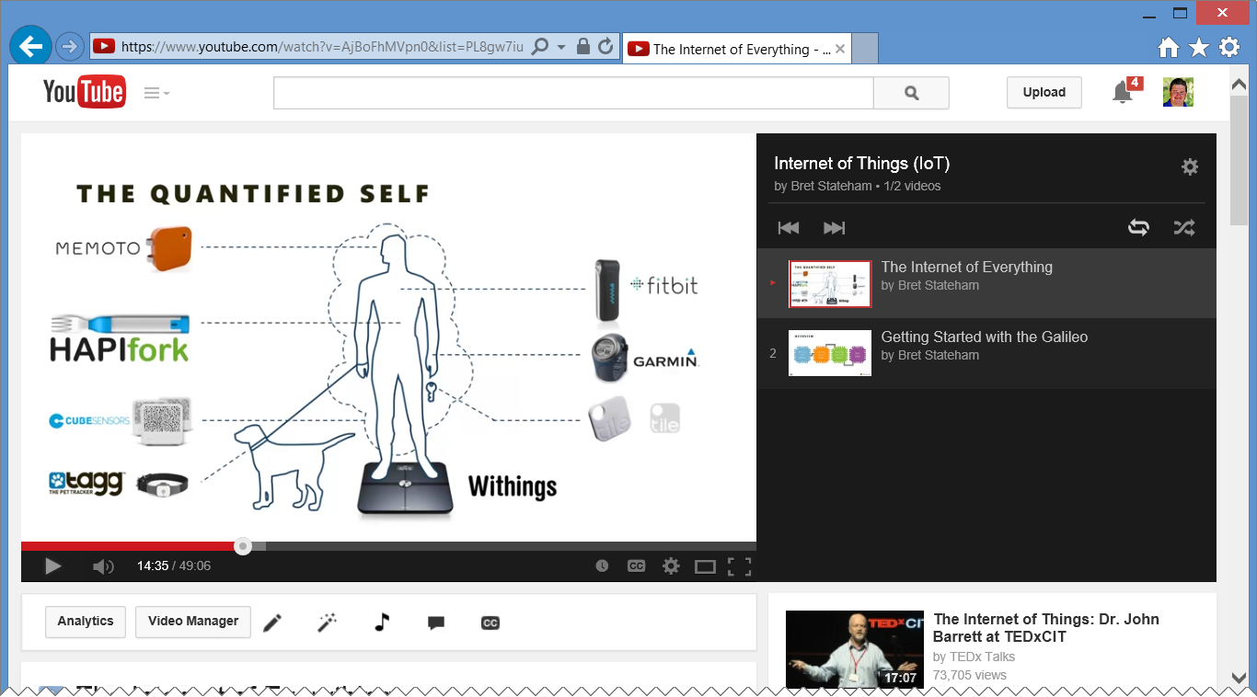
Watch other videos in the series…
http://aka.ms/iotvids

Slide 33
REVIEW
Windows Developer Program for IoT
Installing Windows on Galileo
Running Code
In Windows
Next Steps

Slide 34
IoT Logo

Slide 35
arduino

Slide 36
GALILEO BOARD

Slide 37
LEDs

Slide 38
Resistors
220Ω
1st Digit
2nd Digit
Multiplier
Tolerance
Color | Name | 1st Digit | 2nd Digit | Multiplier | Tolerance
 | Black | 0 | 0 | X1
 | Brown | 1 | 1 | X10 | 1%
 | Red | 2 | 2 | X100
 | Orange | 3 | 3 | X1,000
 | Yellow | 4 | 4 | X10,000
 | Green | 5 | 5 | X100,000
 | Blue | 6 | 6 | X1,000,000
 | Violet | 7 | 7
 | Grey | 8 | 8
 | White | 9 | 9
 | Gold |  |  | X0.1 | 5%
 | Silver |  |  | X0.01 | 10%
330Ω
10KΩ

Slide 39
USB and power cables

